Slide 2
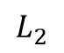
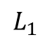
G
$$L_{1}$$
$$L_{2}$$
S
P

Slide 3
$$M_{1}$$
S
$$γ$$
G
$$α$$
$$φ$$
$$θ$$
$$L_{2}$$
D
$$∆x$$

Slide 4
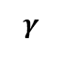
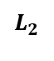
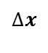
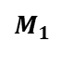
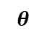
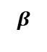
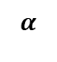
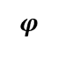
$$M_{1}$$
S
$$γ$$
G
$$α$$
$$L_{2}$$
$$β$$
D
$$θ$$
$$∆x$$
$$φ$$

Slide 5
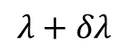

$$λ+δλ$$
$$λ$$

Slide 6
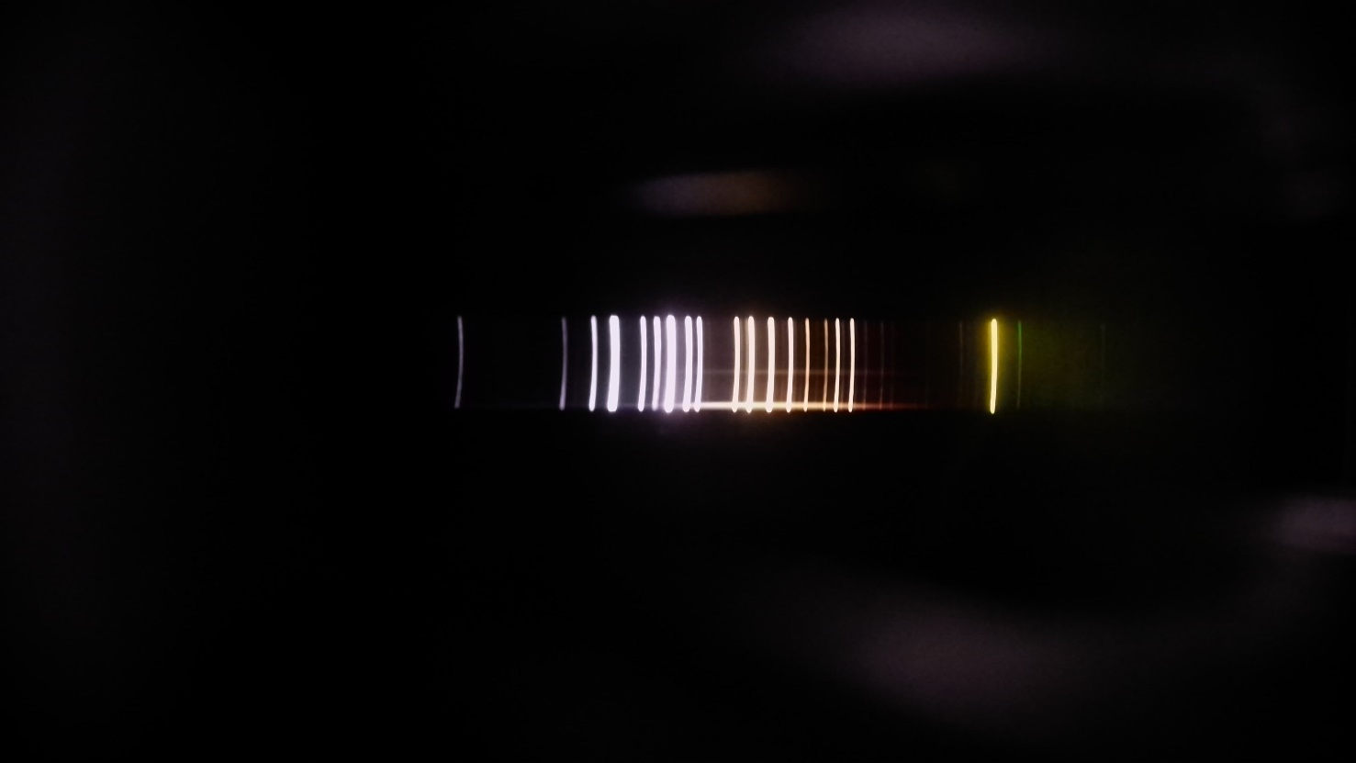
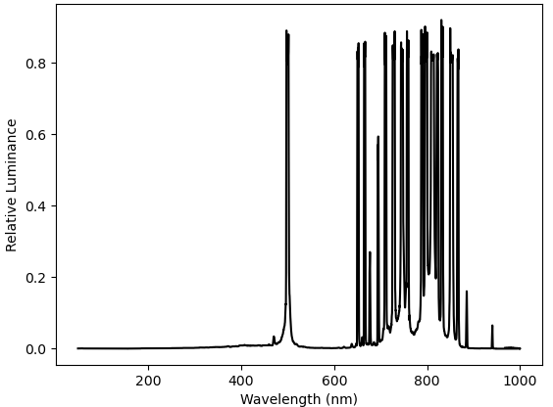


Slide 7
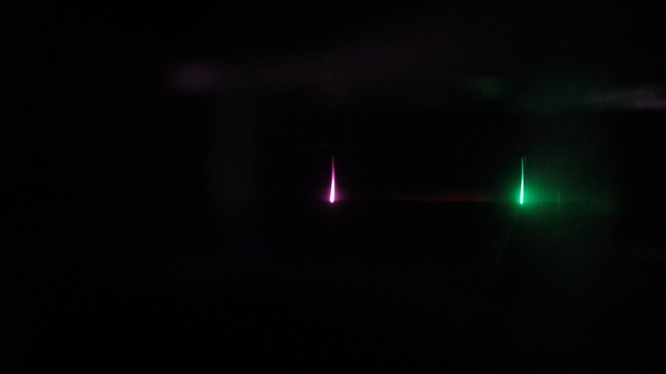
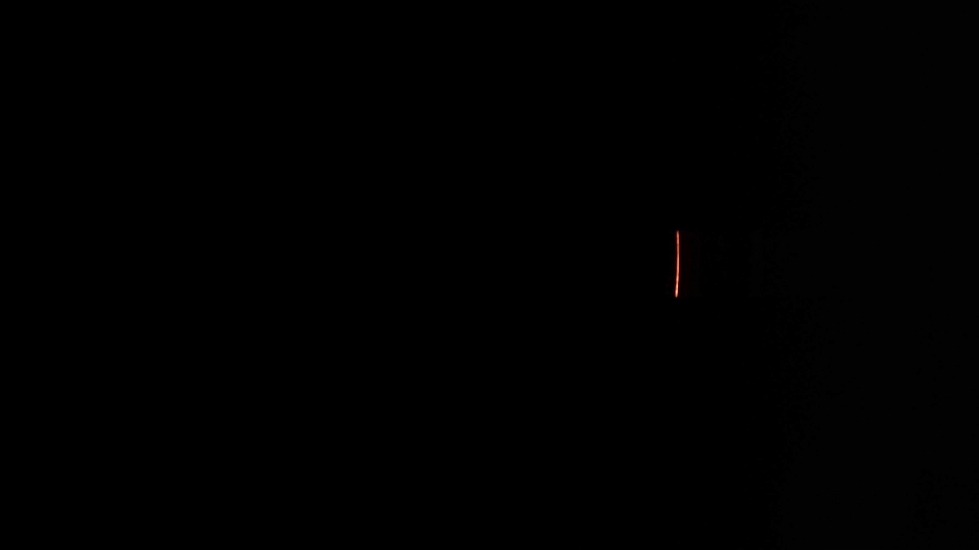
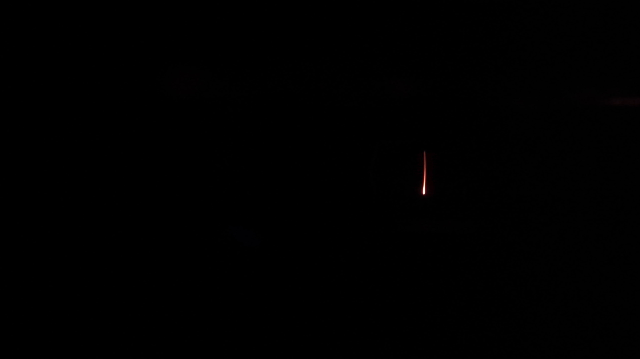

Slide 8
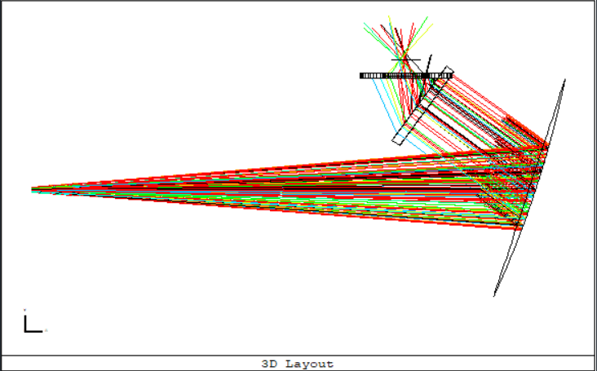
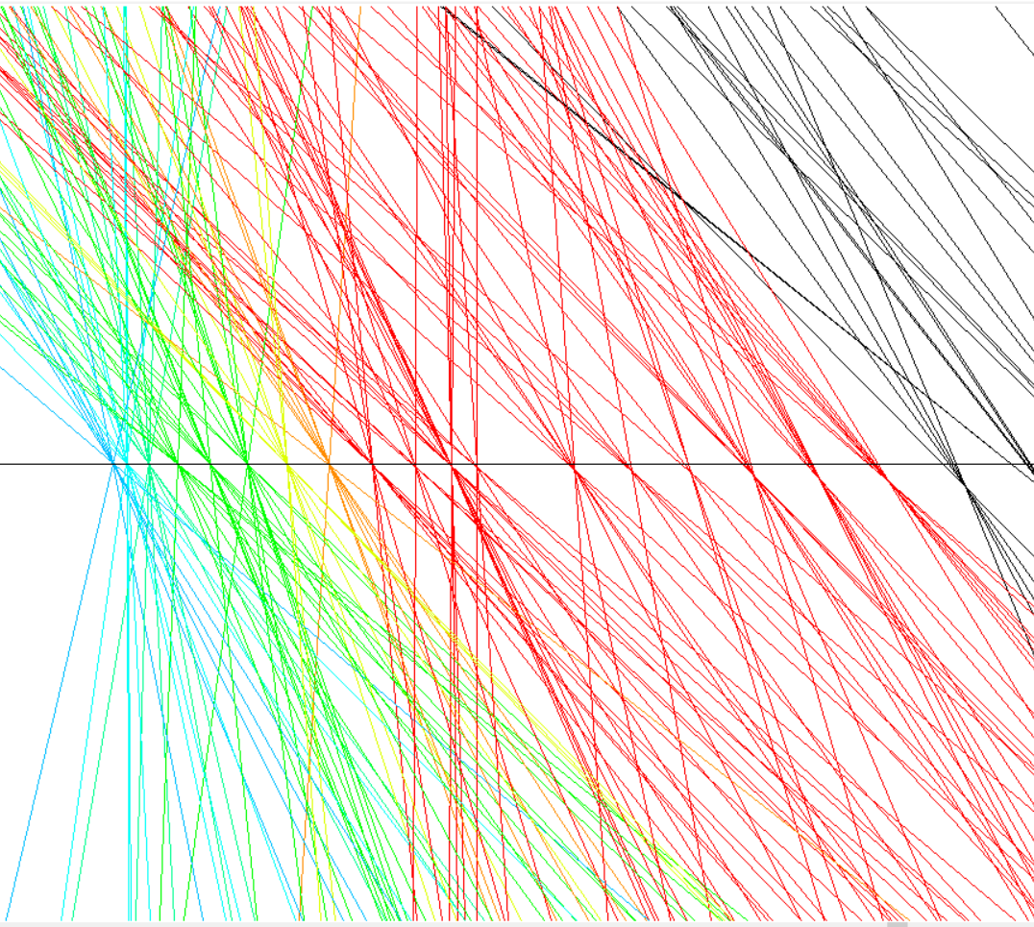

Slide 9
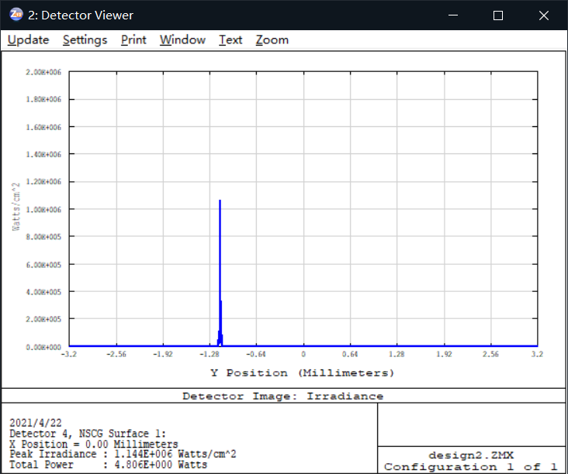
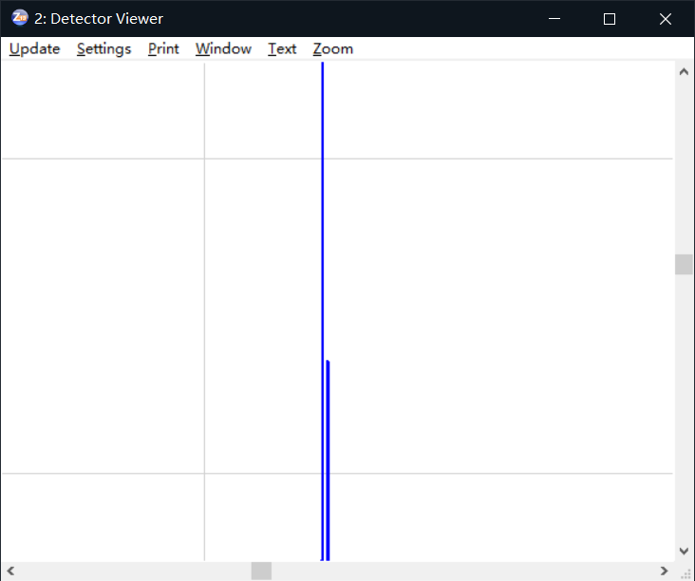

Slide 10
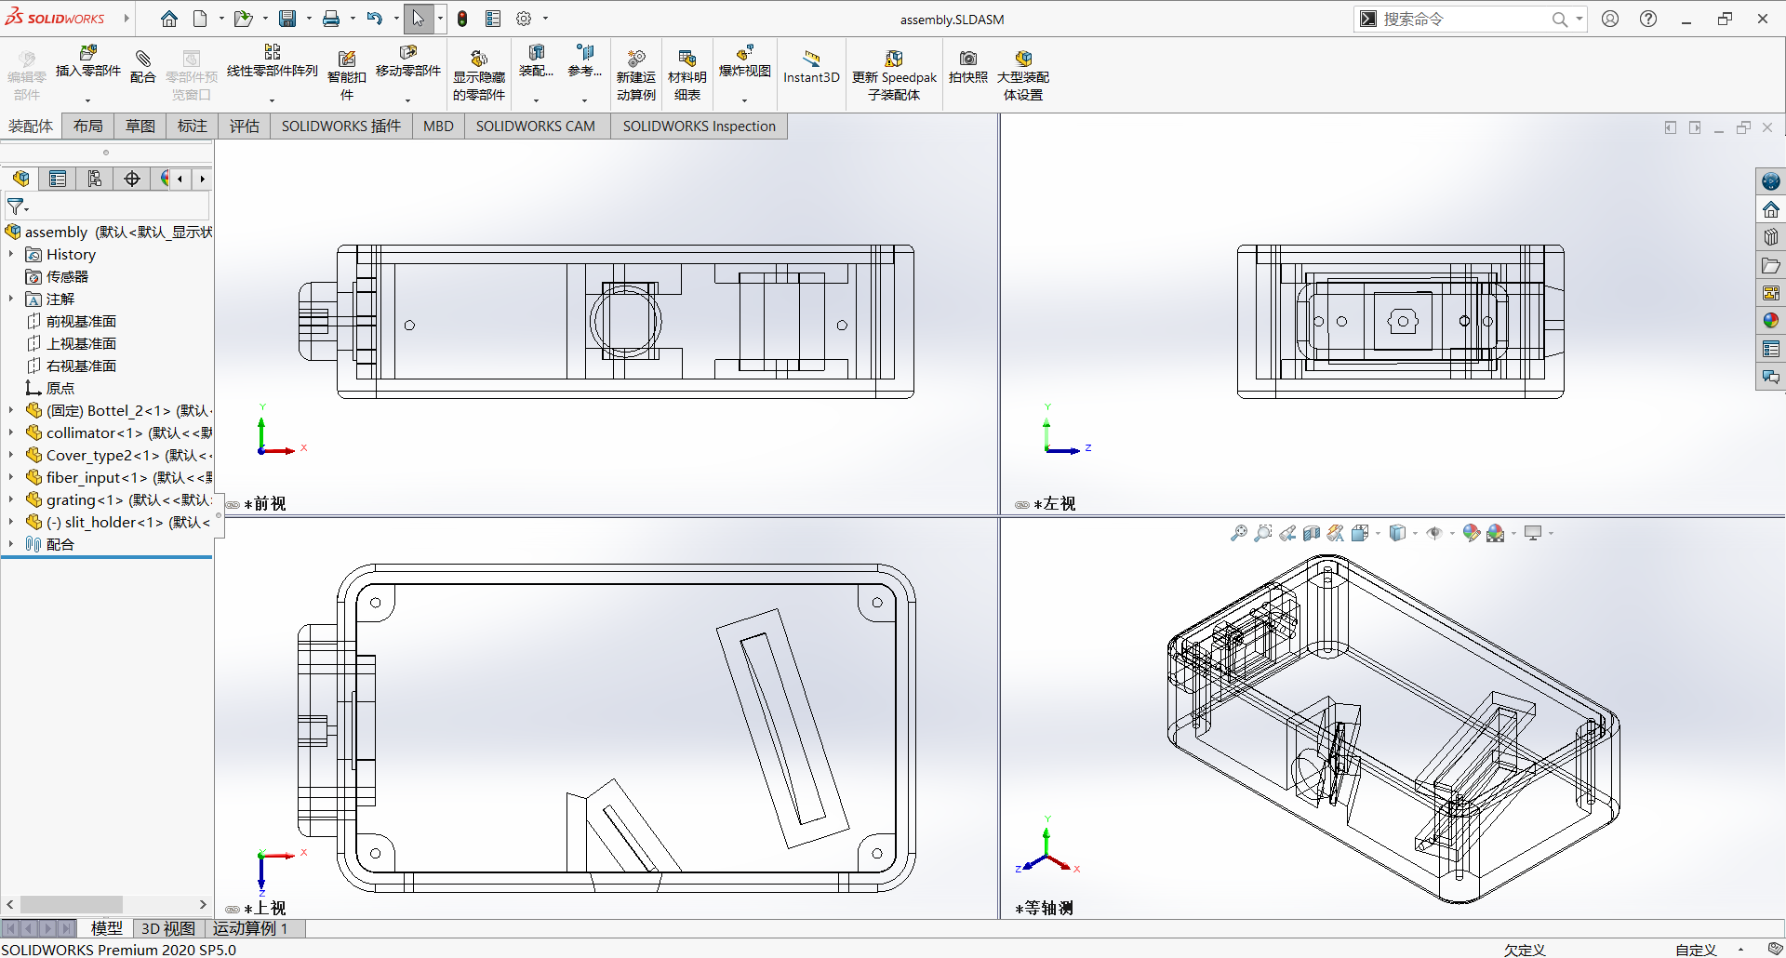
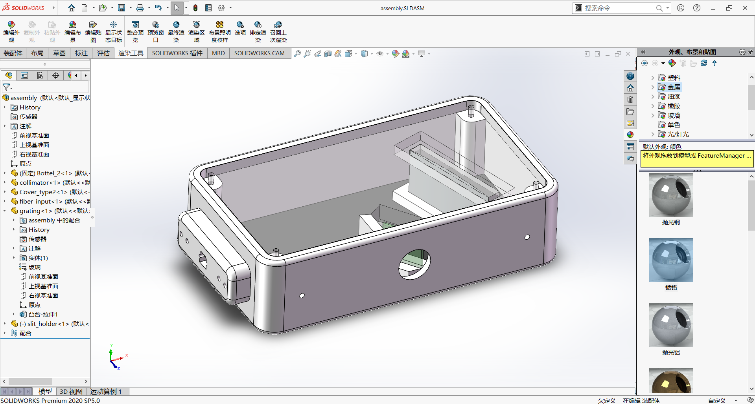

Slide 11
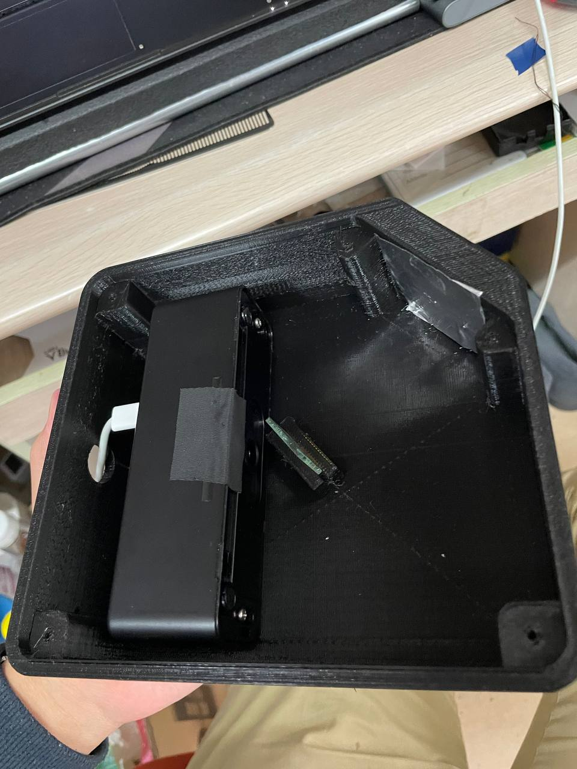
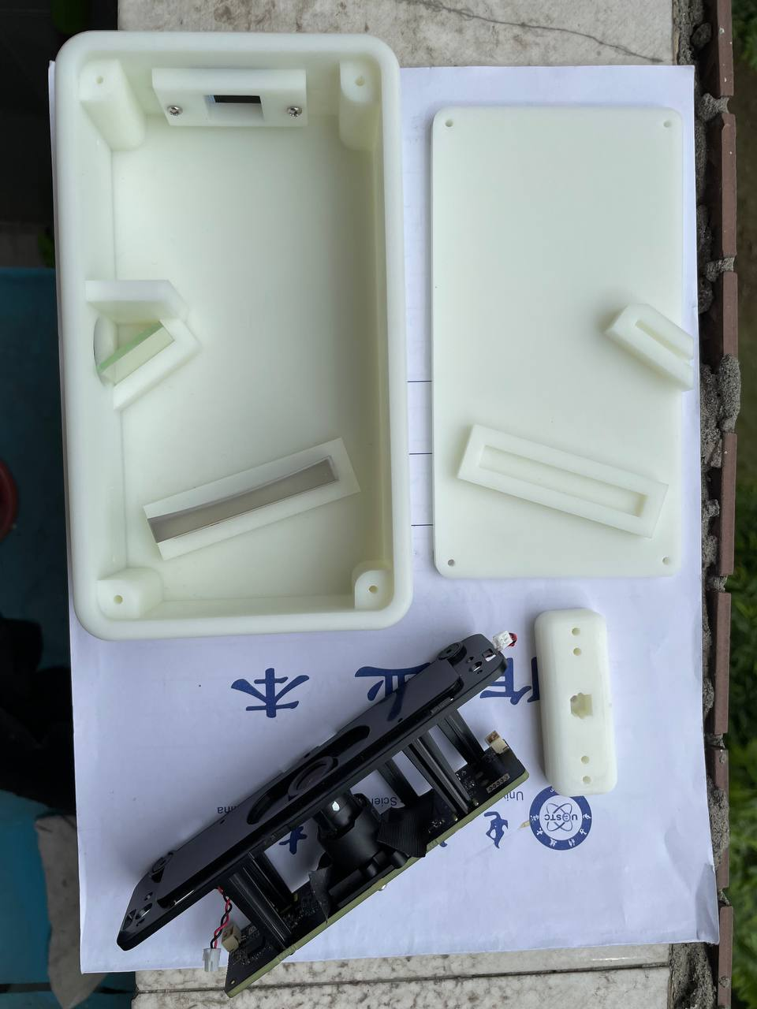

Slide 12
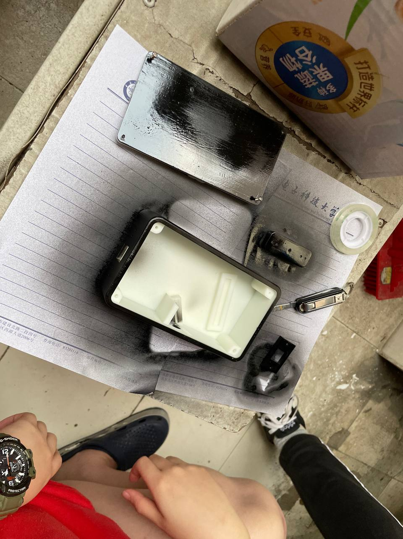
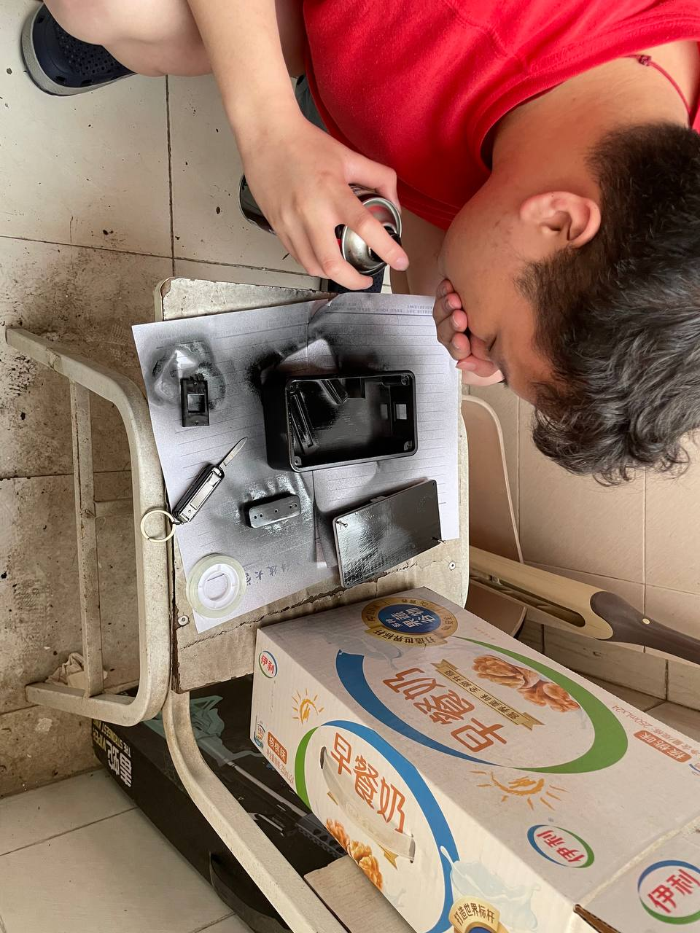
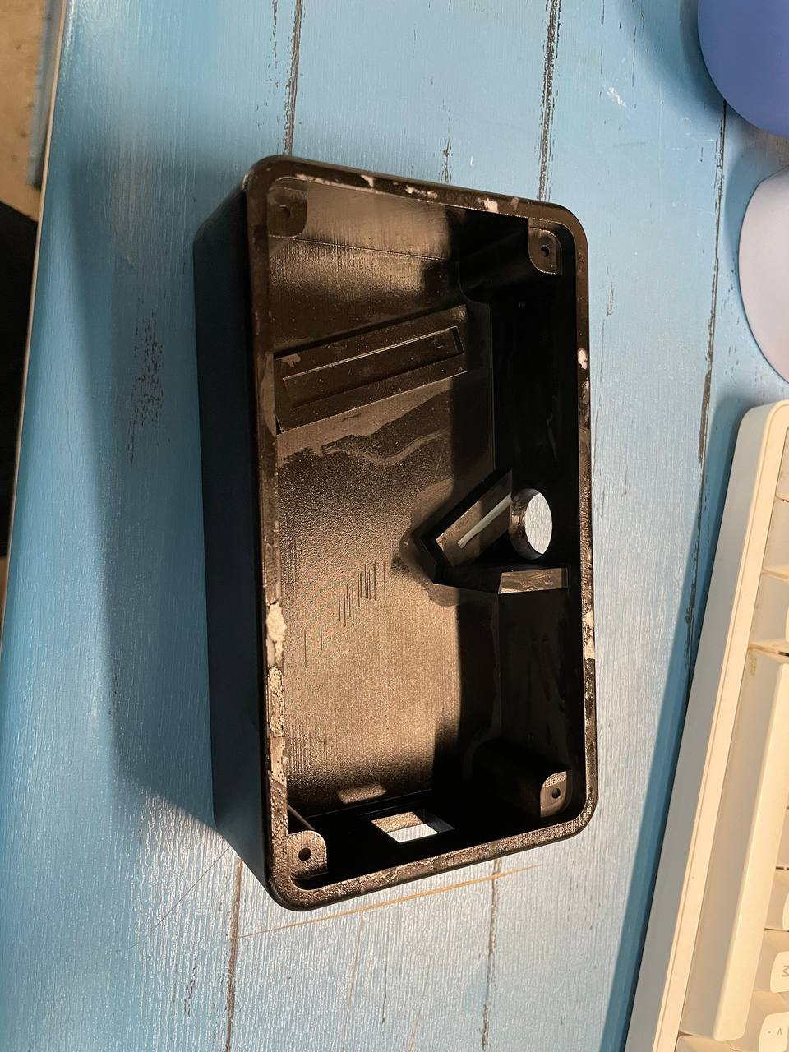
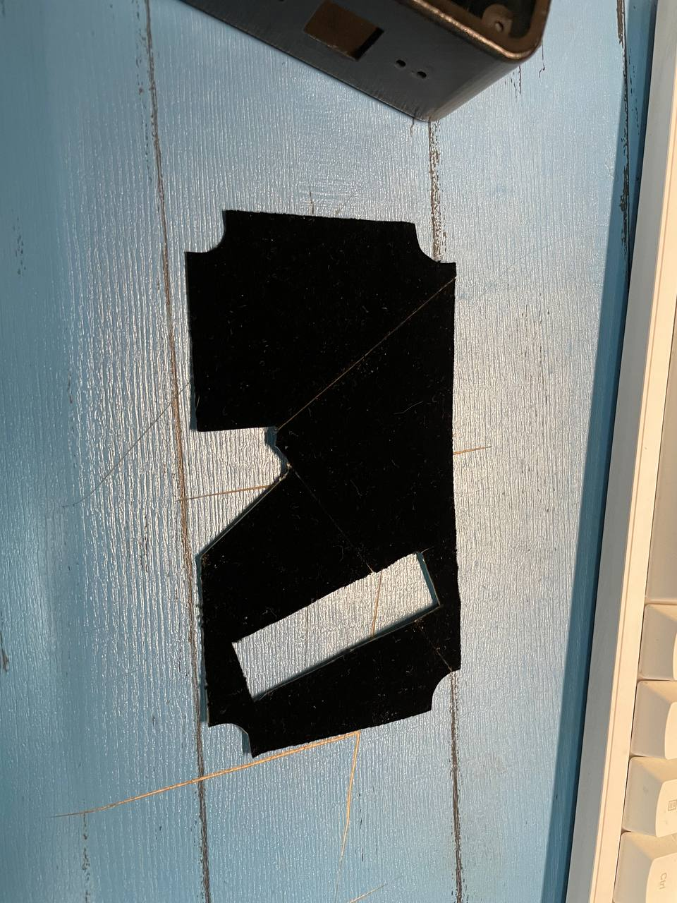
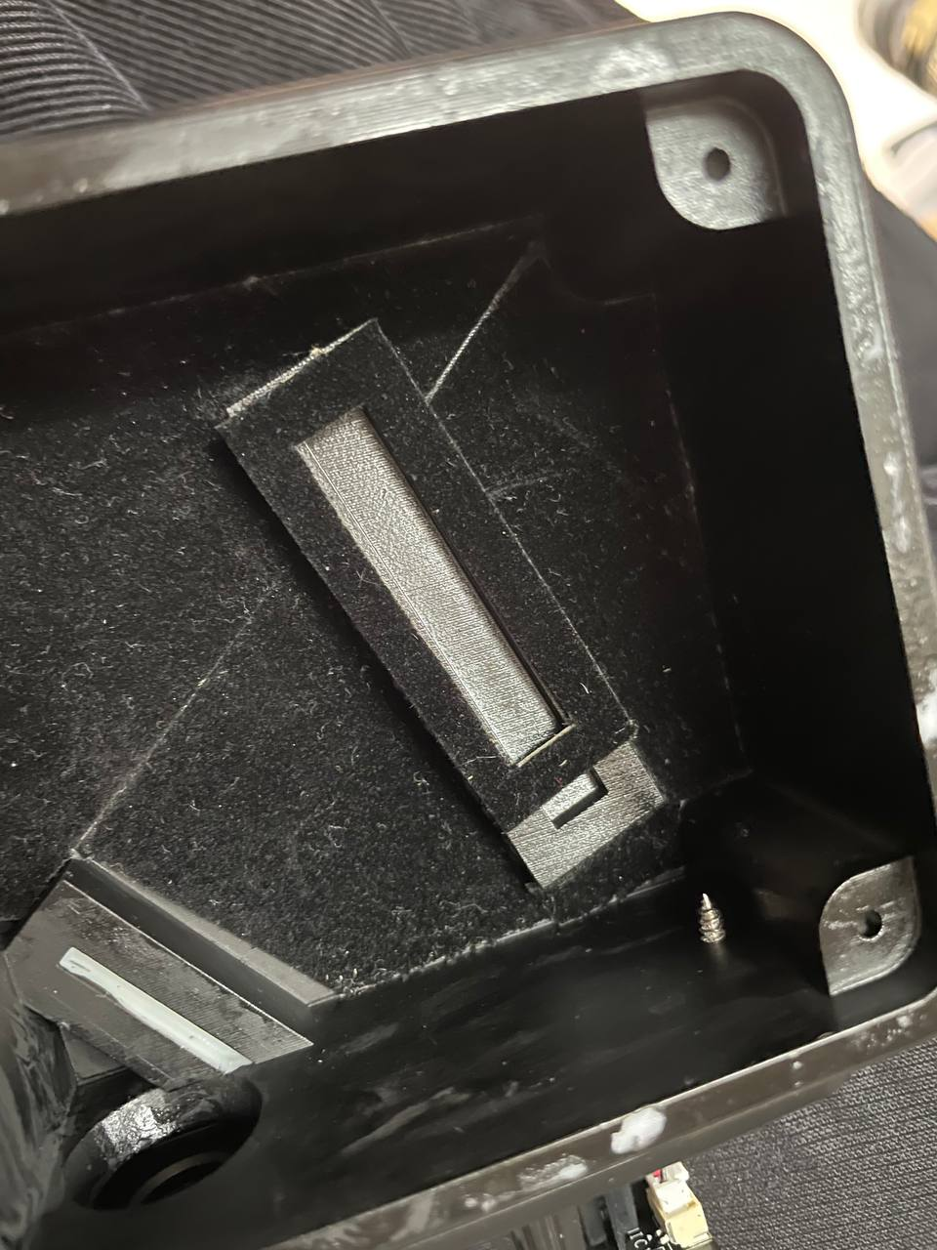

Slide 13
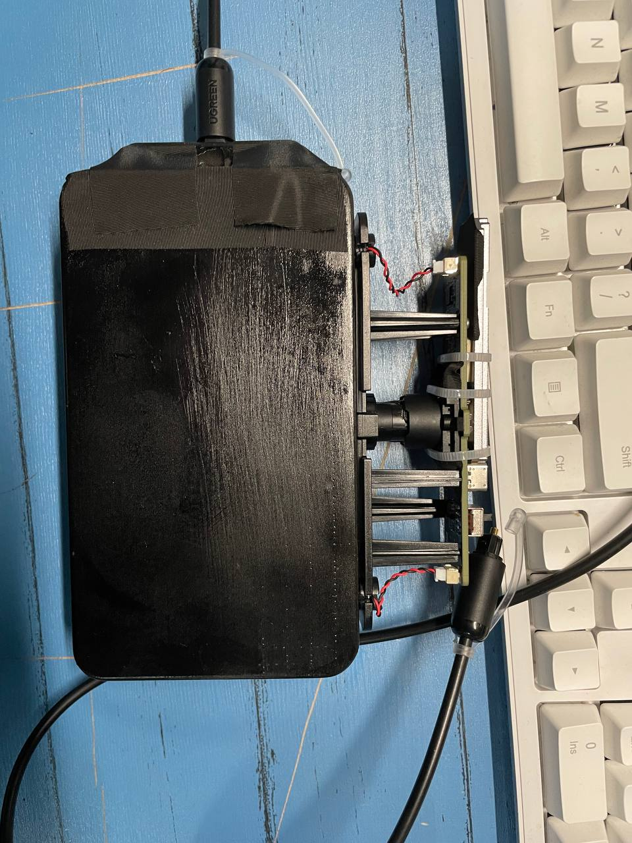
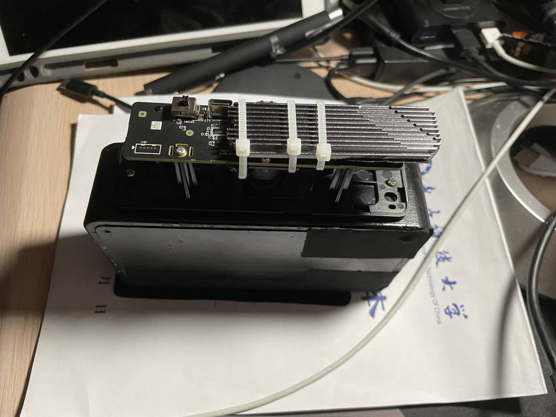
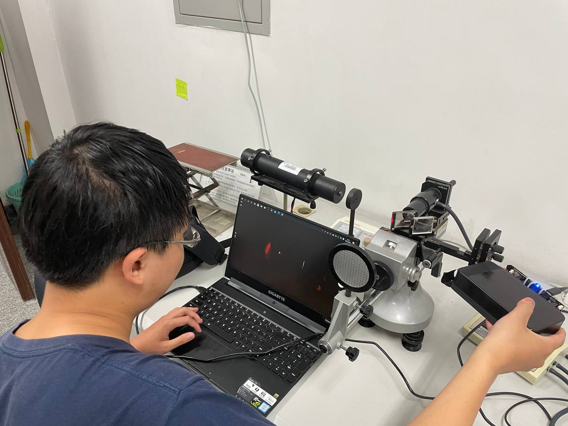
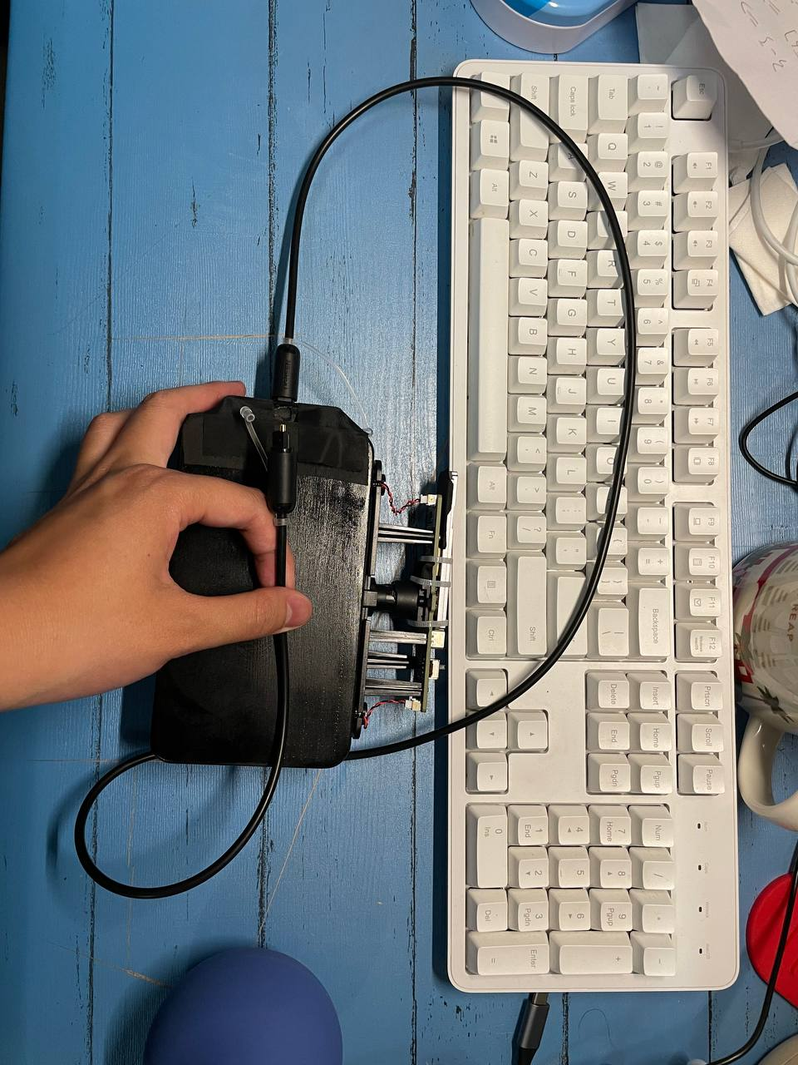
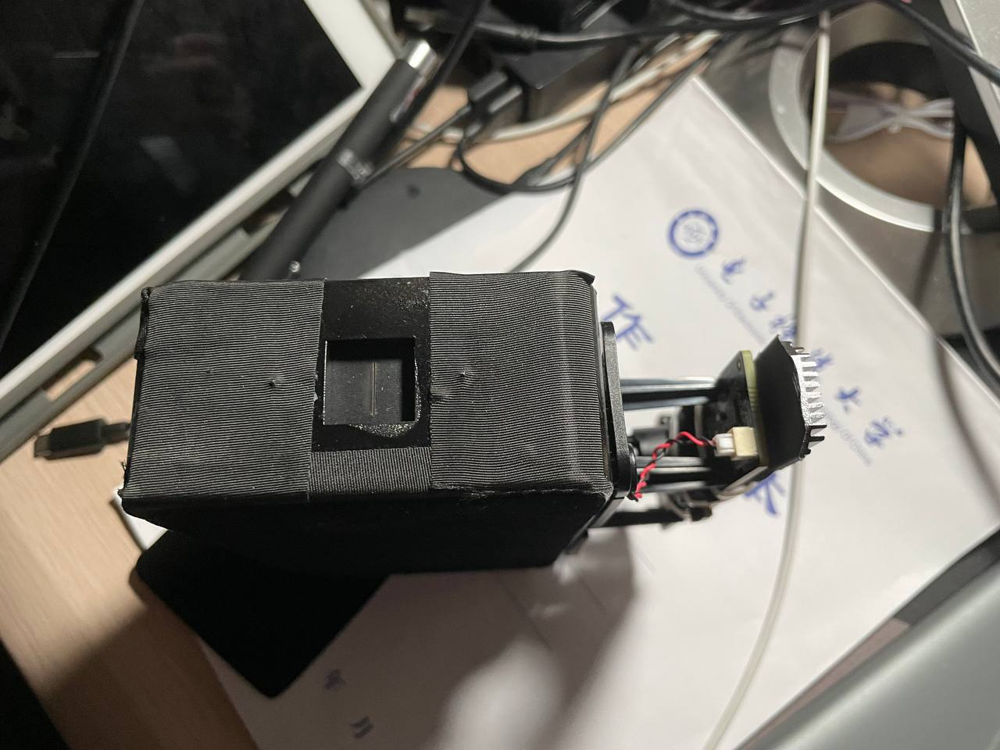
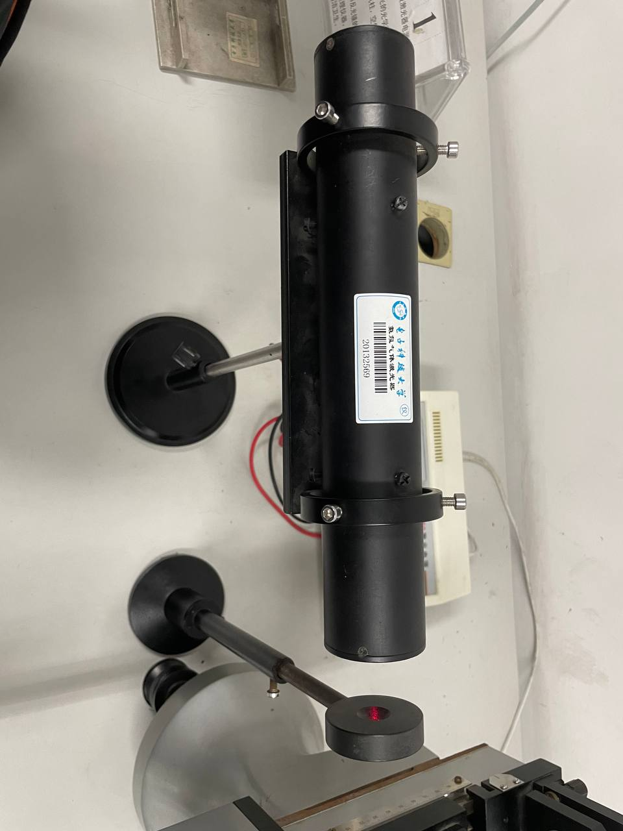
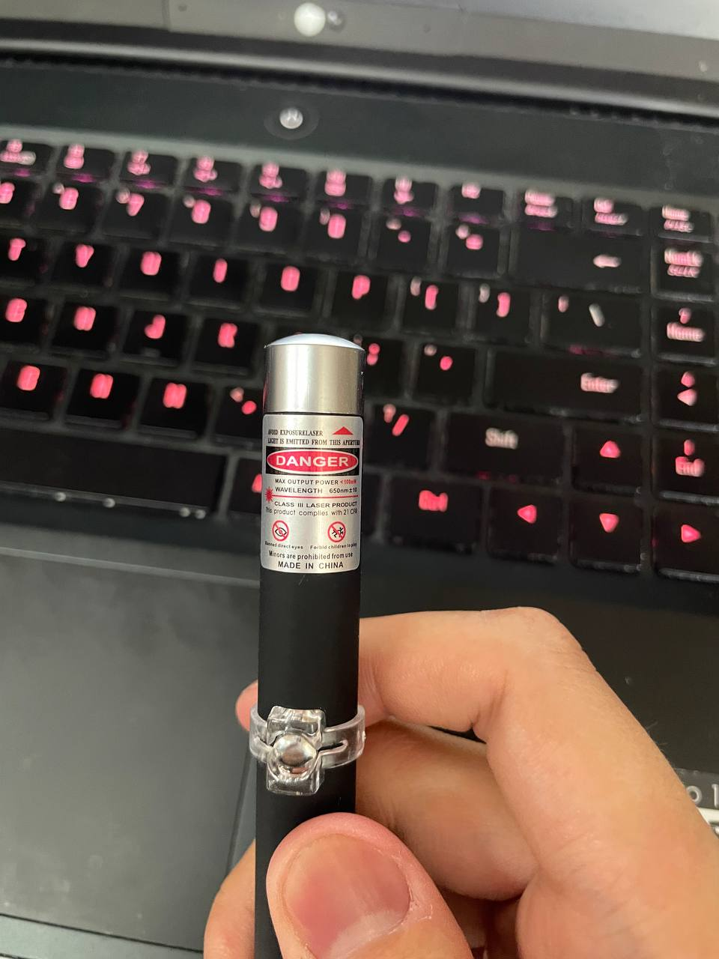
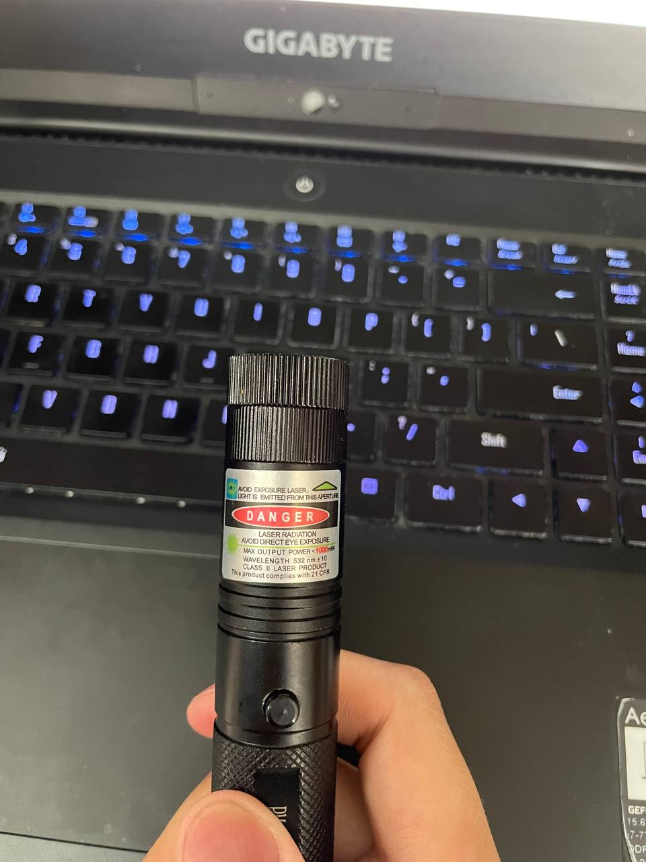
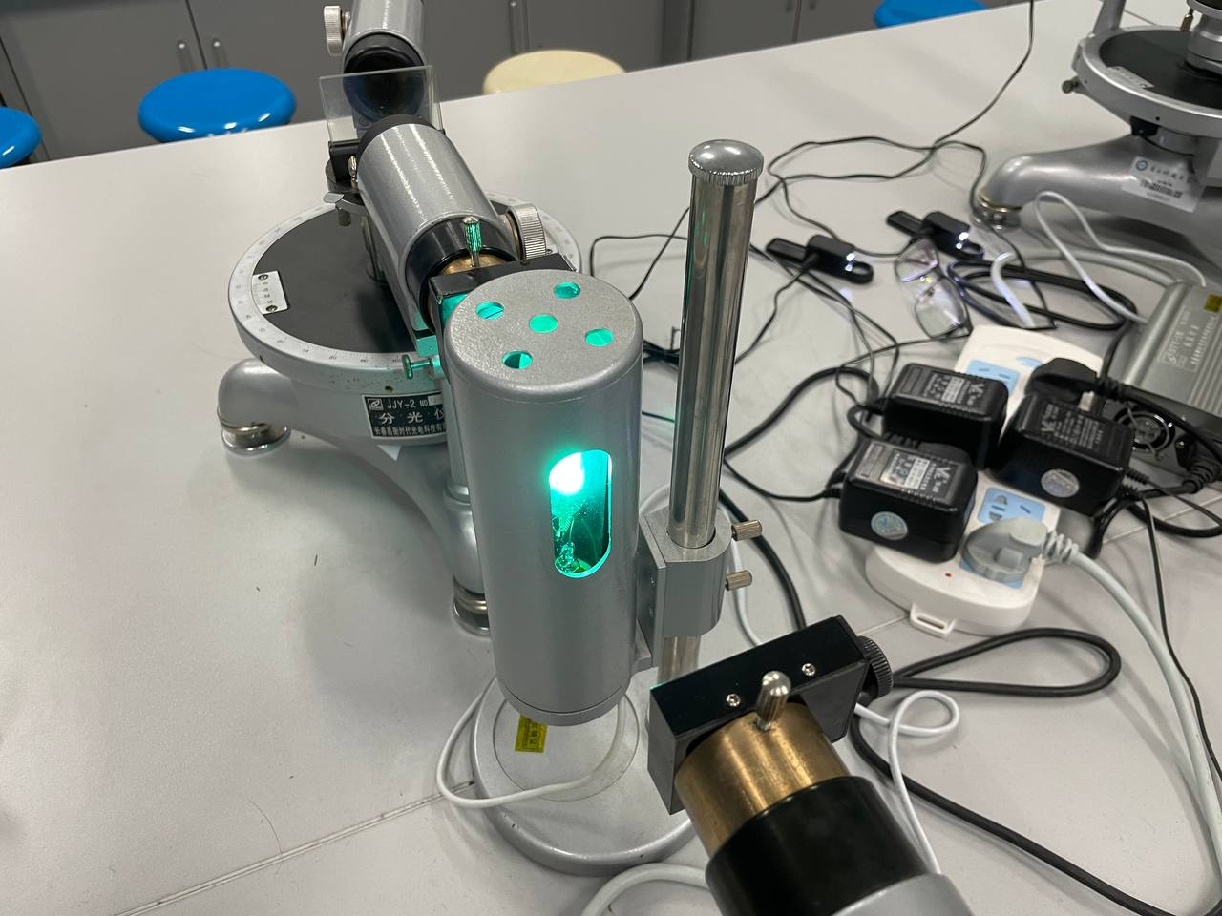

Slide 14
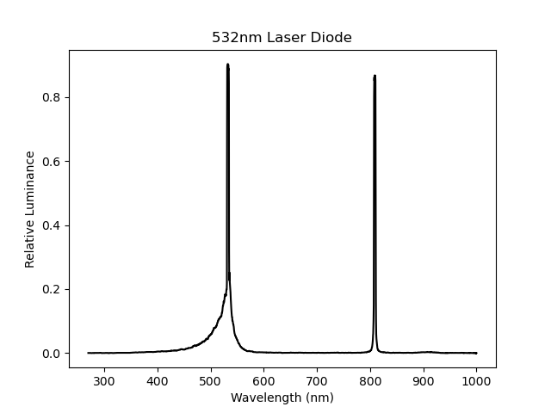
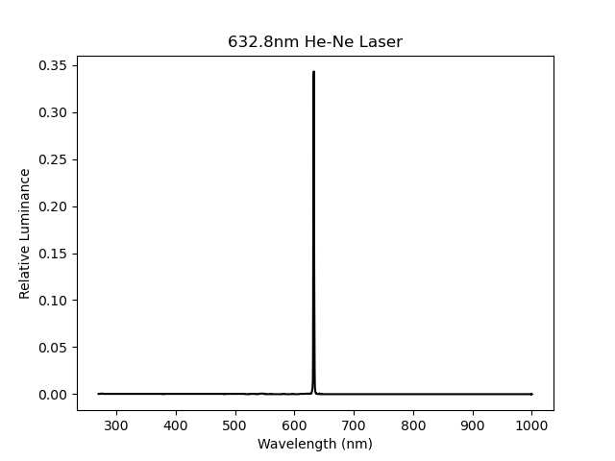
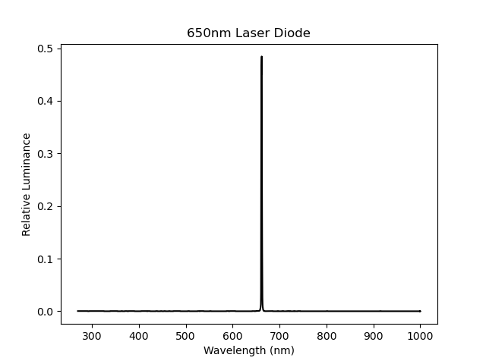

Slide 15
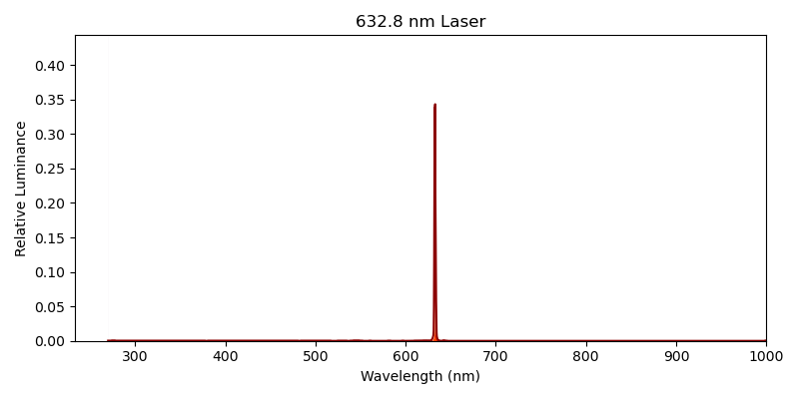

Slide 16
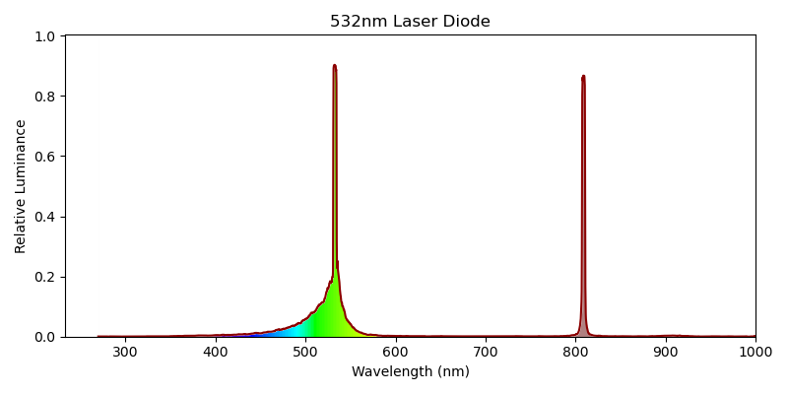

Slide 17
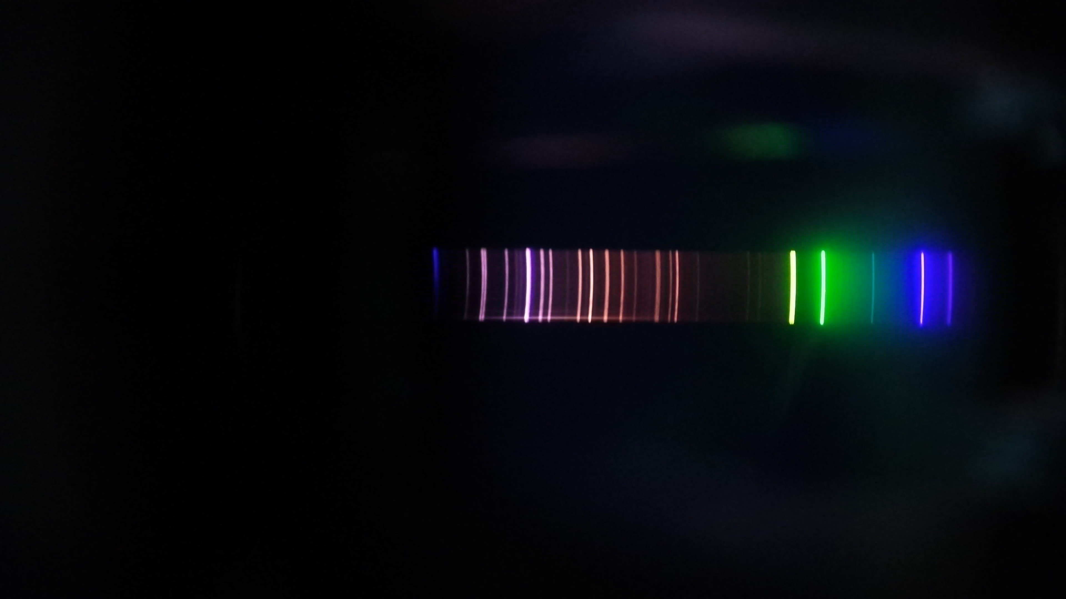
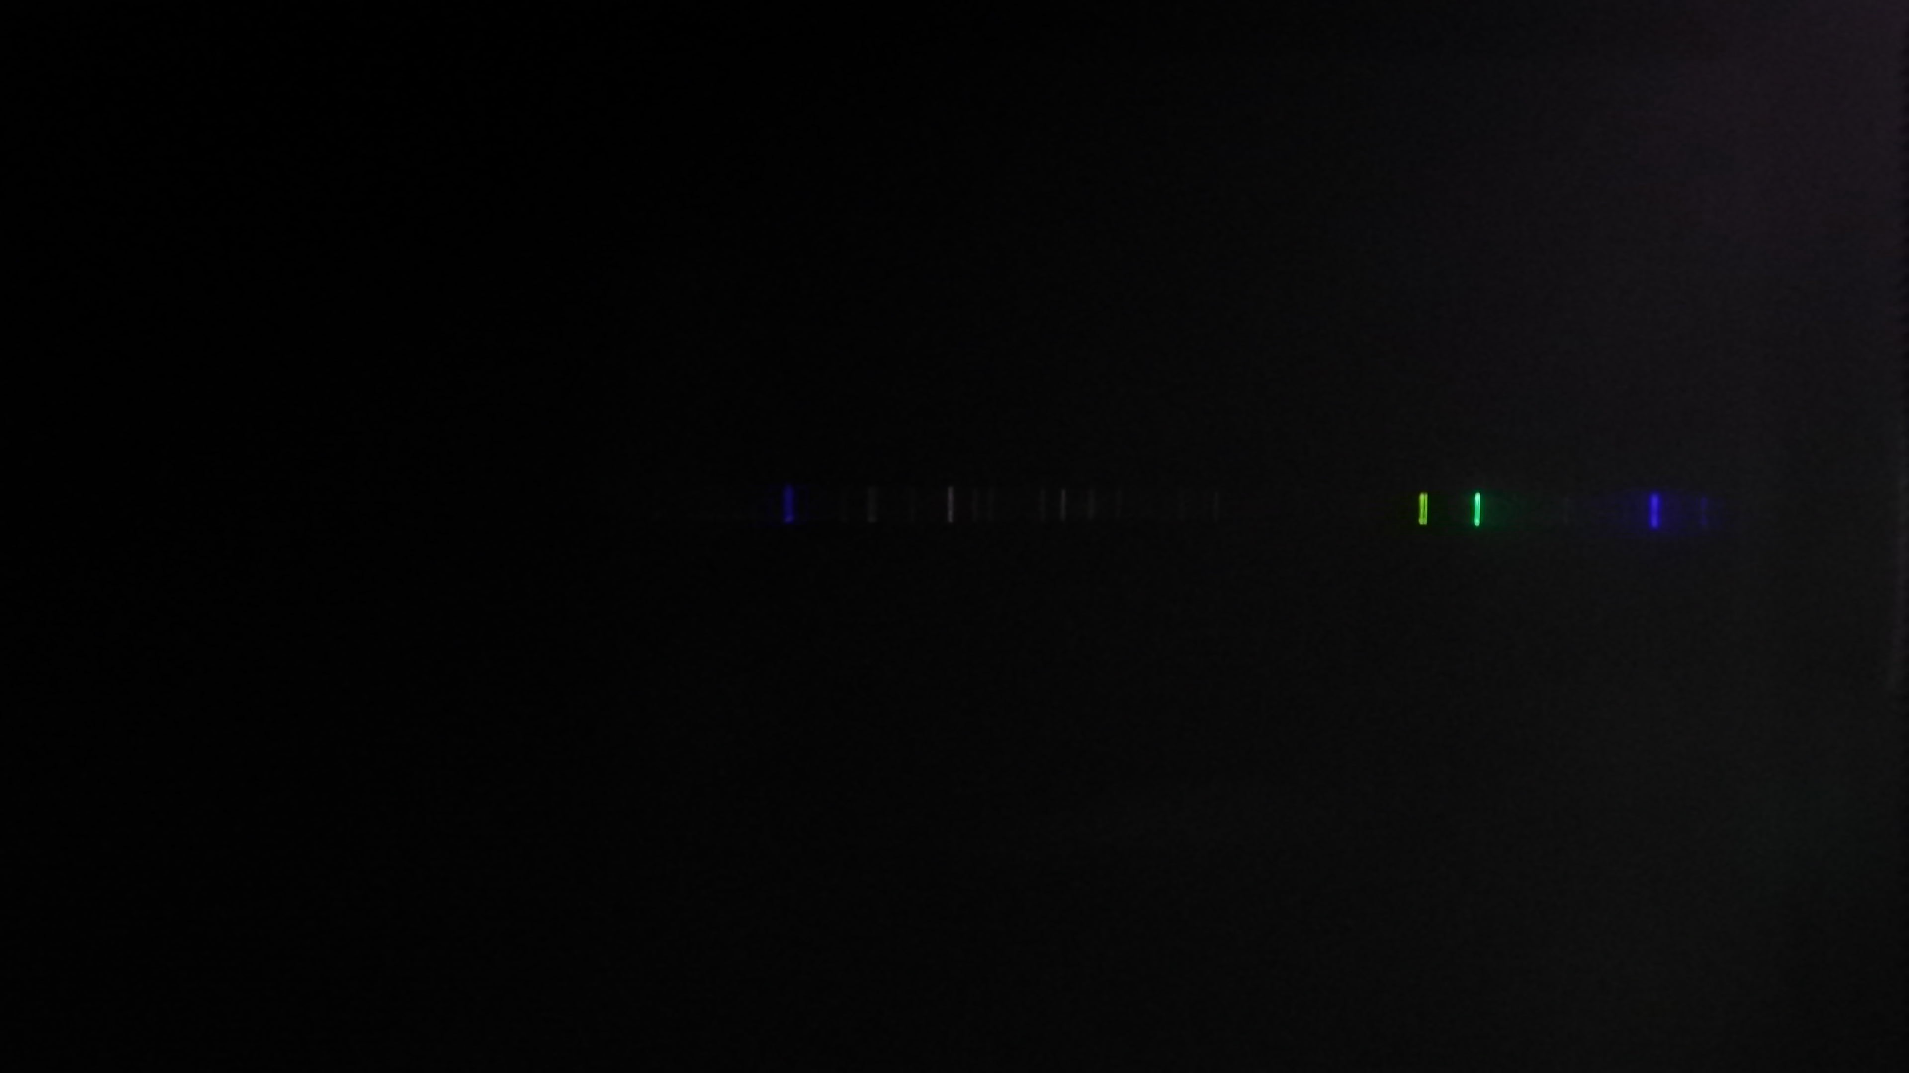
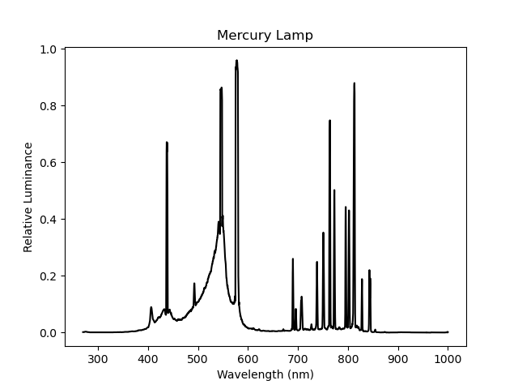
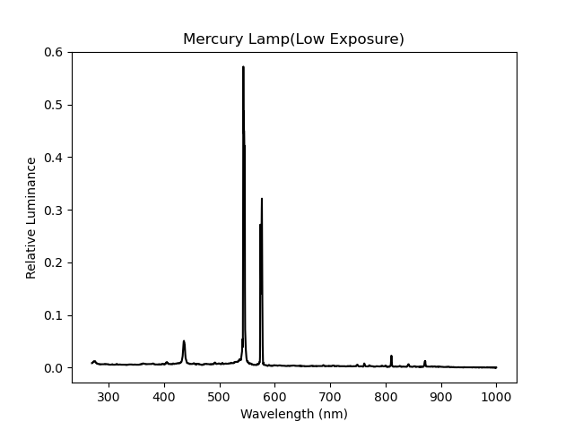

Slide 18
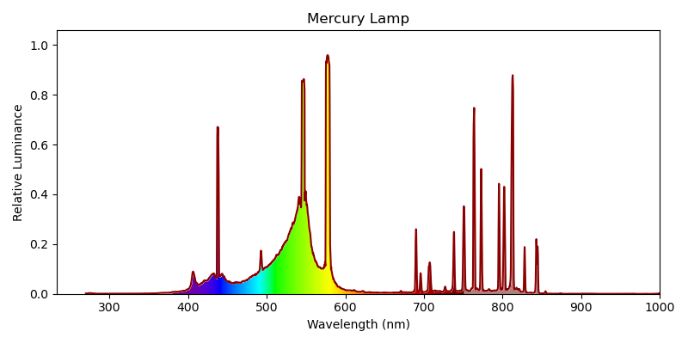

Slide 19
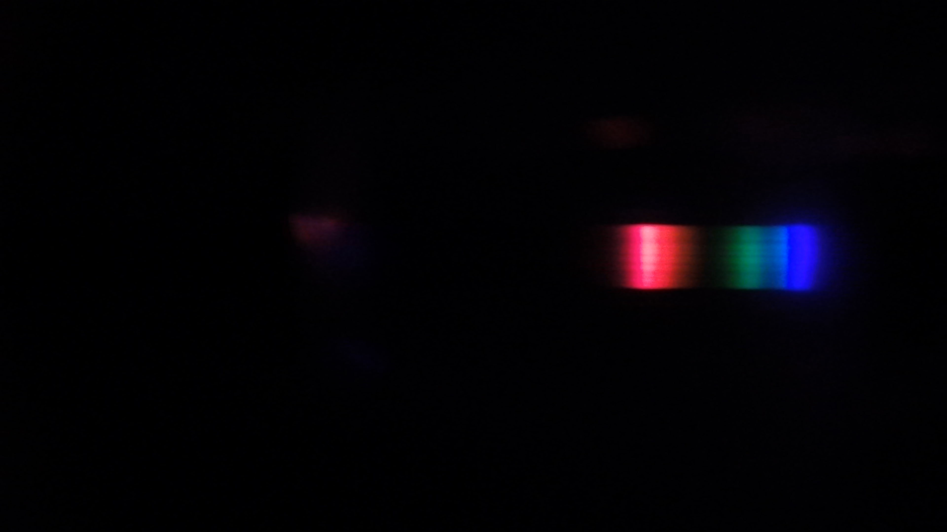
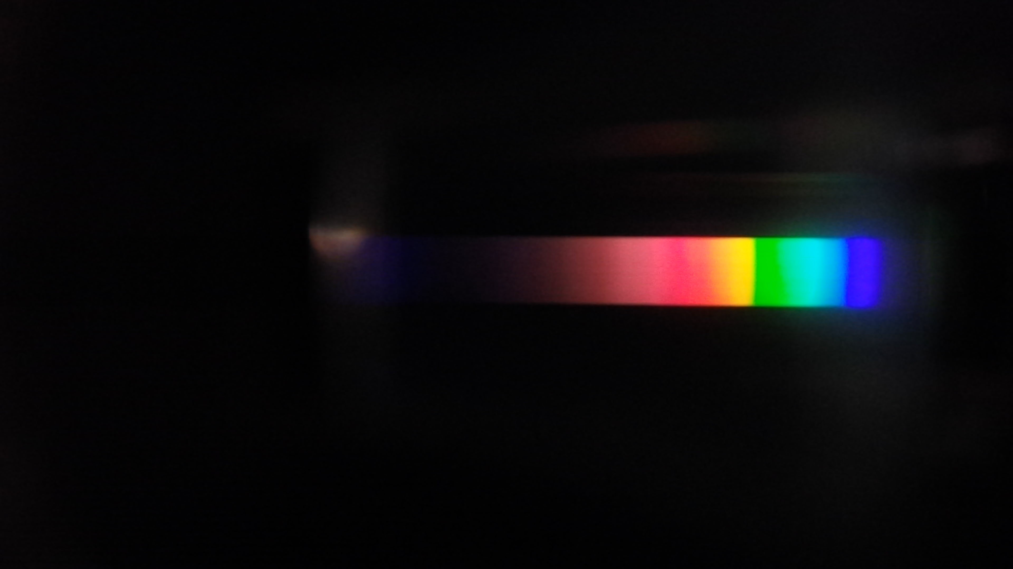



Slide 20


Slide 21


Slide 22



Slide 23


Slide 24





Slide 25


Slide 26


Slide 27


Slide 28


Slide 29






$$D$$
$$L_{1}$$
$$L_{2}$$
$$w_{s}$$
$$w_{d}$$
$$S$$

Slide 30


Hardware Design
Diffraction Grating
$$dy_{0}=C^{′}\sin\left[2π\left(\frac{t}{T}−\frac{r_{0}+xsinθ}{λ}\right)\right]dx$$
$$y= \int_{−\frac{a}{2}}^{\frac{a}{2}}{C^{′}\sin\left[2π\left(\frac{t}{T}−\frac{r_{0}+xsinθ}{λ}\right)\right]dx}$$

Slide 31


Hardware Design
Diffraction Grating
$$y= \int_{−\frac{a}{2}}^{\frac{a}{2}}{C^{′}\sin\left[2π\left(\frac{t}{T}−\frac{r_{0}+xsinθ}{λ}\right)\right]dx}$$
$$+\int_{b+\frac{a}{2}}^{b+\frac{3a}{2}}{C^{′}\sin\left[2π\left(\frac{t}{T}−\frac{r_{0}+xsinθ}{λ}\right)\right]dx}$$
$$+\int_{2b+\frac{3a}{2}}^{2b+\frac{5a}{2}}{C^{′}\sin\left[2π\left(\frac{t}{T}−\frac{r_{0}+xsinθ}{λ}\right)\right]dx}+…$$
$$+\int_{\left(N−1\right)b+\frac{2N−3}{2}a}^{\left(N−1\right)b+\frac{2N−1}{2}a}{C^{′}\sin\left[2π\left(\frac{t}{T}−\frac{r_{0}+xsinθ}{λ}\right)\right]dx}$$
$$y=C^{′}a\frac{sinu}{u}\frac{sinNv}{sinv}sin⁡[2π\left(\frac{t}{T}−\frac{r_{0}}{λ}−\frac{(N−1)(a+b)sinθ}{2λ}\right)]$$
Where $u=\frac{πasinθ}{λ}$, and $v=\frac{\left[π\left(a+b\right)sinθ\right]}{λ}$.

Slide 32

Hardware Design
Diffraction Grating
$$I=A^{2}={C^{′}}^{2}a^{2}\frac{\sin^{2}{u}}{u^{2}}\frac{\sin^{2}{Nv}}{\sin^{2}{v} }$$
Where $u=\frac{πasinθ}{λ}$, and $v=\frac{\left[π\left(a+b\right)sinθ\right]}{λ}$.
$$d\left(sinφ±sinθ\right)=kλ$$
Grating Equation

Slide 33
Hardware Design
Diffraction Grating
when $v=kπ$, $\frac{\sin^{2}{Nv}}{\sin^{2}{v} }$ has maximum
$$\left(a+b\right)sinθ=±kλ, k=0,1,2,…$$
$$d\left(sinφ±sinθ\right)=kλ$$
Grating Equation

Slide 35

Hardware Design
Sensor’s Physical Resolution

Slide 36




Hardware Design
Rayleigh Criterion
$$θ=\frac{0.61λ}{a}$$
Fraunhofer single slit diffraction

Slide 37







Hardware Design
Width of Slit’s Image
$$D$$
$$L_{1}$$
$$L_{2}$$
$$w_{s}$$
$$w_{d}$$
$$w_{D}=\frac{F_{focuser}}{F_{collimator}}w_{S}$$
$$S$$

Slide 38


$$∆x$$
Spectra Line of $λ$ Wavelength Light

Slide 39
Result

Slide 40







